Slide 1
Lecture 5: Central Tendency and Dispersion- II
1

Slide 2
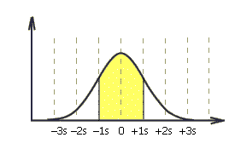
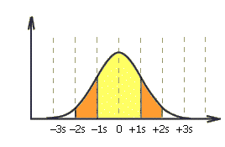

The Empirical Rule…
If the histogram is bell shaped
Approximately 68% of all observations fall within one standard deviation of the mean.
Approximately 95% of all observations fall
within two standard deviations of the mean.
Approximately 99.7% of all observations fall
within three standard deviations of the mean.
2

Slide 3
Empirical Rule
Data are normally distributed (or approximately normal)
Distance from the Mean |  |  | Percentage of Values Falling Within Distance
 | μ ± 1σ μ ± 2 σ μ ± 3σ |  | 68 95 99.7
3

Slide 4
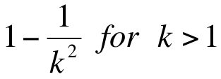
Chebysheff’s Theorem…Not often used because interval is very wide.
A more general interpretation of the standard deviation is derived from Chebysheff’s Theorem, which applies to all shapes of histograms (not just bell shaped).
The proportion of observations in any sample that lie within k
standard deviations of the mean is at least:
For k=2 (say), the theorem states that at least 3/4 of all observations lie within 2 standard deviations of the mean. This is a “lower bound” compared to Empirical Rule’s approximation (95%).
41

Slide 5
Coefficient of Variation
Ratio of the standard deviation to the mean, expressed as a percentage
Measurement of relative dispersion
C.V. = ^{σ} (100)
μ

Slide 6
Coefficient of Variation
μ = 29 μ = 84
1
σ ₁ = 4.6
σ
2
σ ₂ = 10
σ
C.V .
=
1
(
100)
C.V .
=
2
(
100)
μ
μ
1
2
1
2
= ^{4.6} (100)
= ¹⁰ (100)
29
= 15.86
84
= 11.90

Slide 7
Variance and Standard Deviation of Grouped Data
Population
Sample
∑ ^{f} ( M − μ )²
∑ f ( M − X )²
_{σ} 2 ₌
σ =
S
2
=
n − 1
N
_{S} 2
σ
S =
2

Slide 8
Population Variance and Standard Deviation of Grouped Data(mu=43)
M
M−μ ( _{M}
− μ )²
^{f} ( M − μ )²
Class Interval
f
fM
20-under 30
30-under 40
40-under 50
50-under 60
60-under 70
70-under 80
6
18
11
11
3
1
25
35
45
55
65
75
150
630
495
605
195
75
2150
-18 | 324
-8 | 64
2 | 4
12 | 144
22 | 484
32 | 1024
1944
1152
44
1584
1452
1024
7200
50
_{σ}2 ₌
^{f} ( M − μ )²
∑
σ =
144 =12
σ
2
=
= ⁷²⁰⁰ = 144
N
50

Slide 9
Measures of Shape
Skewness
Absence of symmetry
Extreme values in one side of a distribution
Kurtosis
Peakedness of a distribution
Leptokurtic: high and thin
Mesokurtic: normal shape
Platykurtic: flat and spread out
Box and Whisker Plots
Graphic display of a distribution
Reveals skewness

Slide 10
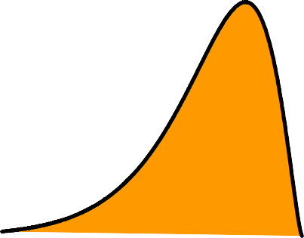
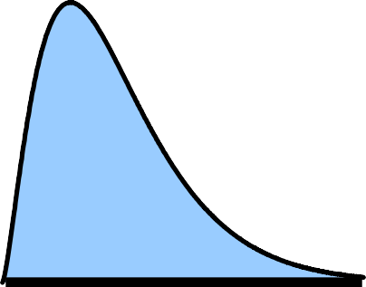
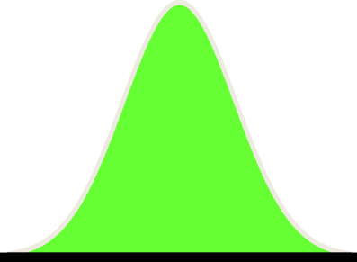
Skewness
Negatively Skewed
Symmetric
(Not Skewed)
Positively Skewed

Slide 11
Skewness..
The skewness of a distribution is measured by comparing the relative positions of the mean, median and mode.
Distribution is symmetrical
Mean = Median = Mode
Distribution skewed right
Median lies between mode and mean, and mode is less than mean
Distribution skewed left
Median lies between mode and mean, and mode is greater than
mean

Slide 12
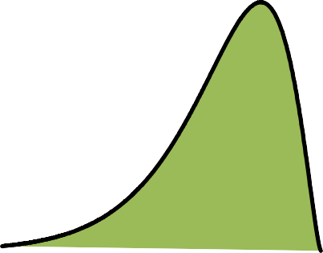
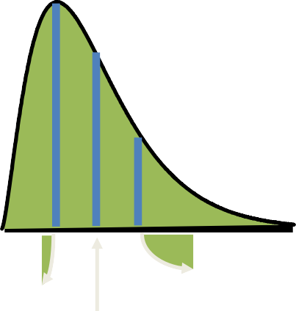
Skewness
Mean
Mode
Mean Median Mode
Symmetric (Not Skewed)
Mode
Mean
Median
Negatively Skewed
Median
Positively
Skewed

Slide 13
Coefficient of Skewness
Summary measure for skewness
3(μ − Md )
σ
S =
If S < 0, the distribution is negatively skewed (skewed to the left)
If S = 0, the distribution is symmetric (not skewed)
If S > 0, the distribution is positively skewed (skewed to the right)

Slide 14
Coefficient of Skewness
μ = 23 1 M_{d1} = 26 σ₁ = 12.3 3(μ₁ − M_{d1}) S₁ = _{σ} 1 ₌ 3(23 − 26) 12.3 = −0.73 | μ = 26 2 M_{d 2} = 26 σ ₂ = 12.3 3(μ₂ − M_{d 2}) S₂ = _{σ} 2 ₌ 3(26 − 26) 12.3 = 0 | μ = 29 3 M_{d 3} = 26 σ ₃ = 12.3 3(μ₃ − M_{d 3}) S₃ = _{σ} 3 ₌ 3(29 − 26) 12.3 = +0.73

Slide 15
Kurtosis
Peakedness of a distribution
Leptokurtic: high and thin
Mesokurtic: normal in shape
Platykurtic: flat and spread out
Leptokurtic
Mesokurtic
Platykurtic

Slide 16
Box and Whisker Plot
Five specific values are used:
Median, Q₂
First quartile, Q₁
Third quartile, Q₃
Minimum value in the data set
Maximum value in the data set

Slide 17
Box and Whisker Plot
Minimum
Q₁
Q₂
Q₃
Maximum

Slide 18
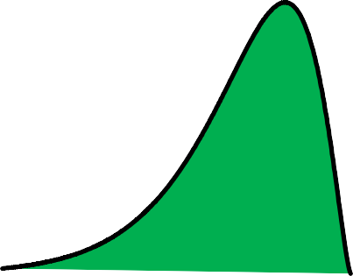

Skewness: Box and Whisker Plots, and Coefficient of Skewness
S = 0
S > 0
S < 0
Negatively
Skewed
Symmetric
(Not Skewed)
Positively
Skewed

Slide 19
THANK YOU

